Slide 1
Identity Protection M365 Business Premium + Microsoft Entra ID P2 Add On
Add Microsoft Entra ID P2 to M365 Business Premium to strengthen your identity management with advanced risk-based conditional access, seamless authentication and comprehensive governance to secure user access.

Slide 2
Today's identity and access challenges demand a holistic solution
Accelerated growth of identities and apps, on and off the corporate network, requiring secure, user-friendly access.
Massive rise in identity attacks – more than 7,000 password attacks per second ¹, increasing risk of compromised accounts.
Evolving regulations and compliance requirements for protecting identities and auditing access rights.
In Australia, $98M was lost to email compromise and identity theft in 2021-2022² – highlighting the critical need for advanced identity protection.
Microsoft Digital Defense Report 2024
ACSC – Annual Cyber Threat Report 2022

Slide 3
Current state of business
Remote & hybrid work
Increased used of cloud applications
Inconsistent and ineffective identity controls
Higher operational complexity and costs
The rise of remote and hybrid work has led to a growing number of users and devices accessing company resources from various locations, creating difficulties in securing identities and managing access effectively.
SMBs in ANZ are rapidly adopting cloud services, which introduces new complexities in identity management and increases the risk of unauthorised access across multiple platforms and environments.
Many SMBs still rely on basic or inconsistent identity and access controls, leaving gaps that can be exploited by attackers and making it difficult to enforce secure, compliant access policies.
The combination of remote work, cloud adoption and inadequate identity controls leads to higher operational complexity and costs for SMBs, as they struggle to maintain security, compliance and efficient identity management at scale.

Slide 4
Strengthening identity security
To effectively address the challenges faced by SMBs in ANZ, businesses must take proactive steps to strengthen their identity security posture:
Implement Advanced Identity Protection
Consolidate Identity Management
Automate Access Reviews and Certifications
Adopt Governance and Risk Detection
Adopt solutions like multi-factor authentication (MFA) and real-time risk detection to protect identities from unauthorised access.
Use a unified identity platform to centralise management and improve visibility, ensuring consistent access controls across all users, devices and applications.
Regularly perform access reviews, leveraging automation to ensure that only the right people have the appropriate access to sensitive resources.
Enable identity governance tools to detect risky behaviours, unauthorised entitlements and potential vulnerabilities, minimising security gaps and ensuring compliance with regulations.

Slide 5
Microsoft Business Premium: Enhancing collaboration, productivity and security
Microsoft Business Premium offers productivity tools and advanced security for SMBs:
All-in-One Productivity Suite: Includes Office apps, Teams, Exchange, SharePoint and OneDrive.
Advanced Security: Defender for Business protects against threats with endpoint protection, behavioural detection and automated responses.
Device Management: Manage and secure devices centrally with Intune.
In today’s digital landscape, small and medium businesses (SMBs) must balance collaboration and productivity and security advanced identity protection. Here’s how Microsoft Entra ID P2 can help:
Microsoft 365 Business Premium
Cloud Services
Teams
Exchange
OneDrive
SharePoint
Bookings
Loop
Clipchamp
Desktop Apps
Compliance Risks: Advanced risk-based conditional access protects sensitive data by applying policies like MFA when suspicious activity is detected.
Scalability: Grows with your business, managing more users and devices while maintaining secure access.
Automation: Automates access reviews and policy enforcement to reduce administrative overhead and minimise security gaps.
Identity Protection: Real-time risk assessments, token protection and continuous monitoring help detect and mitigate threats, ensuring secure access.
Outlook
Word
Excel
PowerPoint
Publisher (PC Only)
Access (PC Only)
Comprehensive Security
Intune
Purview
Entra ID
Azure Virtual Desktop
Defender for Business
Defender for 0365
$32.90 per user/month

Slide 6
Introducing Microsoft Entra ID P2
Microsoft Entra ID P2 helps organisations strengthen security, ensure compliance and protect identities with advanced features enabling seamless and secure access across environments.
Identity Governance
Comprehensive Identity Protection
Automated access reviews to ensure only necessary access is granted.
Entitlement management to control access to critical applications and data.
Policy enforcement to maintain security and compliance across the organisation.
Advanced multi-factor authentication (MFA) to secure user identities.
Risk-based conditional access to grant access based on user and device risk levels.
Real-time threat intelligence to detect and respond to potential threats quickly.
Advanced Risk Detection
Seamless Integration Across Platforms
In-depth detection of risky behaviours, such as compromised accounts or abnormal access patterns.
Anomaly detection and alerts to identify potential threats in real-time.
Proactive remediation capabilities to address risks before they escalate.
Deep integration with Microsoft 365 and other cloud platforms for consistent access management.
Support for hybrid environments, ensuring security across both on-premises and cloud infrastructures.
Simplified management for IT teams through a unified console for identity and access governance.
+ $13.50 per user/month

Slide 7
M365 Business Premium + Microsoft Entra ID P2
Defender for Business |  | Microsoft Entra ID |  |  |  | Microsoft Intune |  |  |  | Defender for Office
Automated Investigations | Block at First Sight | Administrative Units | Adv Security Reports & Alerts | App Proxy, Including PingAccess | Cloud App Discovery | Application Management |  | Device Management |  | Advanced Anti-Phishing |  | Exchange Online Protection
Cross-platform Support | Endpoint Detection & Response | Conditional Access | Custom Security Attributes | Dynamic Groups | Enterprise State Roaming | Endpoint Analytics |  |  |  | Real-Time Reports |  | Safe Attachments & Links
Next Gen Protection | Mobile Threat Defense | Entra ID Connect Health | External ID | M365 Identity Manager | Password Protection
 |  |  |  |  |  | Windows Protection
Threat Analytics | Vulnerability Management (Core) | Self-Service Group Management | Self-Service Password Reset in AD | Service Level Agreement | Shared Account Password Roll-Over | Application Control | App Locker |  | Windows Update for Business |  | Application Guard |  | Windows Hello for Business
Web Content Filtering | Tamper Protection | Single Sign-On to Other Saas | SMS Sign-in | Temporary Access Pass | Terms of Use | Defender Antivirus | Windows Firewall |  | Bitlocker and Bitlocker to Go |  | Windows Conditional Access
Enhanced ASR |  | Verified ID | Windows Autopilot | 3rd Party MFA Integration | Access Reviews
 |  | Entitlement Management | Entra ID Protection | MFA Registration Policy | Privileged Identity Management
 |  | Risk Based Conditional Access |  |  |  |  |  |  |  |  | M365 Business Premium |  | Entra ID P2

Slide 8
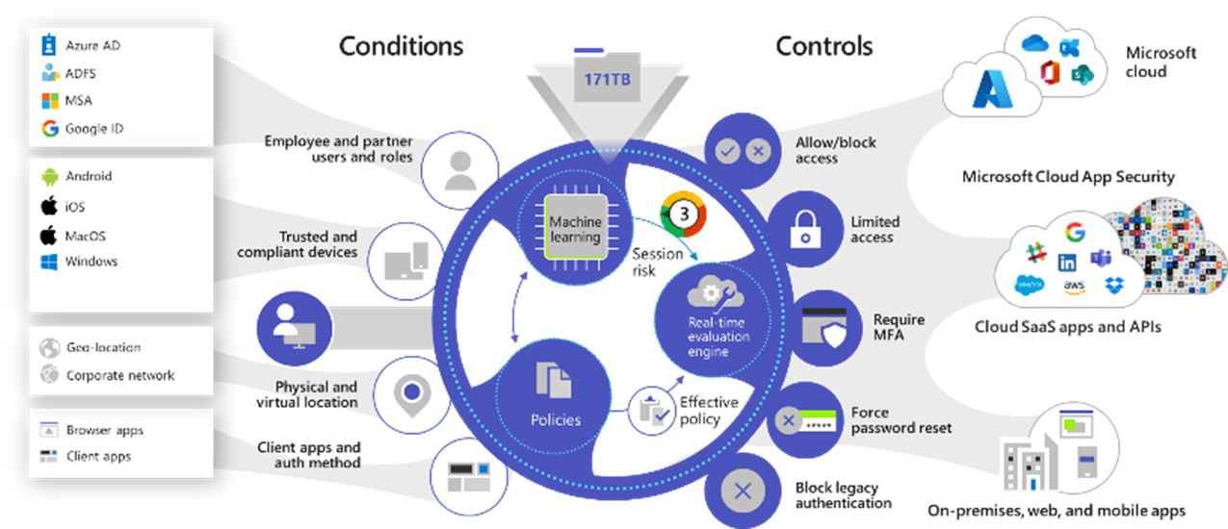
Introducing Microsoft Entra ID P2
Image Source: Microsoft

Slide 9
Added value of Microsoft Entra ID P2
Risk-Based Conditional Access
Adaptive Policies for Secure and Seamless Access
Risk-based conditional access uses real-time risk evaluation to enforce adaptive access policies, ensuring secure resource access without impacting productivity. Stricter controls, like MFA, are applied only when needed, minimising disruptions.
Intelligent Risk Assessment:
Continuously evaluates session risk based on user behaviour, location and device signals, enabling precise enforcement of security policies. This approach reduces exposure to threats while maintaining usability.
Real-Time Dynamic Sign-In Assessment
Instant Risk Detection to Prevent Unauthorised Access
Real-time dynamic sign-in assessment monitors login activities for anomalies, such as unfamiliar devices or unusual locations, and takes immediate action to mitigate potential threats before access is granted.
Proactive Threat Response
Automatically flags suspicious sign-ins and applies controls like MFA or session restrictions to safeguard resources from unauthorised attempts.

Slide 10
Added value of Microsoft Entra ID P2
Real-Time Dynamic User Assessment
Continuous Monitoring for User Behaviour Risks
Real-time dynamic user assessment analyses ongoing user activities and risk signals to detect suspicious behaviour. This allows for immediate intervention to protect organisational security.
Behaviour-Based Insights
Identifies deviations from normal usage patterns, enabling proactive measures to address potential insider threats or compromised accounts.
Token Protection
Device-Specific Token Security to Prevent Misuse
Token protection secures authentication tokens by binding them to specific devices and sessions, ensuring they cannot be reused if stolen. This adds a critical layer of security to authentication processes.
Enhanced Session Security
Restricts token usage to authorised contexts, preventing attacks like token replay or misuse in unauthorised locations.

Slide 11
Added value of Microsoft Entra ID P2
Vulnerabilities and Risky Account Detection
Identify and Address Risks Before They Escalate
Vulnerabilities and risky account detection uses advanced analytics to uncover compromised identities and potential security gaps. Early detection enables swift action to secure sensitive resources.
Proactive Risk Management
Flags suspicious account activity and vulnerabilities, empowering teams to remediate risks and strengthen their security posture.
Risk Event Investigation
Efficient Analysis and Resolution of Identity Threats
Risk event investigation provides detailed insights into identity risks, helping organisations quickly identify and address suspicious activities. This minimises exposure and enhances overall security.
Actionable Insights
Delivers in-depth reporting on risk events, supporting rapid and informed decision-making to mitigate threats.

Slide 12
Added value of Microsoft Entra ID P2
Basic Access Certifications and Reviews
Streamlined Access Compliance Reviews
Access certifications and reviews ensure that user permissions align with security policies and regulatory standards. Periodic reviews prevent excessive or outdated access, improving compliance.
Simplified Certification Process
Automates reviews, making it easier to maintain proper access controls across the organisation.
Basic Entitlement Management
Role-Based Access to Simplify Permissions
Entitlement management automates access requests and approvals, providing users with the right permissions based on roles while reducing administrative overhead.
Operational Efficiency
Ensures appropriate access provisioning through predefined workflows, minimising manual intervention and potential errors.

Slide 13
Added value of Microsoft Entra ID P2
Privileged Identity Management
Securing Elevated Access with Just-in-Time Controls
Privileged identity management (PIM) safeguards critical resources by granting just-in-time privileged access, enforcing approval workflows and continuously monitoring elevated access usage.
Risk Reduction for Privileged Accounts
Limits the duration and scope of elevated access, protecting sensitive systems from overprivileged account misuse.

Slide 14
Strengthen Identity Security with Microsoft Entra ID P2
Proactive Threat Protection
Privilege Access Management
Zero Trust Alignment
Microsoft Entra ID P2 uses AI-driven insights to detect and prevent compromised accounts, risky sign-ins and unusual behaviour, while adjusting security policies in real time based on risk, ensuring your organisation stays secure without disrupting productivity.
Secure privileged accounts and limit access to sensitive resources with just-in-time (JIT) permissions, while maintaining full visibility through auditing and reporting, reducing the risks of elevated privileges.
Enhance your zero trust strategy by using Microsoft Entra ID P2 for visibility into identity risks and making secure access decisions based on user behaviour and identity signals, ensuring a modern defence against cyber threats.
Simplified Compliance and Governance
Scalability for Growing Threats
Microsoft Entra ID P2 simplifies compliance with automated role-based access provisioning and lifecycle management, ensuring regulatory requirements like SOCI and Essential 8 are met while reducing administrative burden.
Microsoft Entra ID P2 scales with your organisation, offering enterprise-grade identity protection that adapts to evolving threats and supports all users, from employees to contractors and customers, ensuring security as your operations grow.

Slide 15
Instructions to customise this page for your business:
Add your company name into the heading
Add your security description under ‘Proven security specialists’
Click icon to add a picture that reflects or business or delete if not required
[Partner Name] is here to support your security journey from foundations to maturity
Your essential cyber security partner
Proven security specialists
Security Risk Assessments, Regulation and Compliance Assessments
Post Assessment Workshops to Deep Dive into Gaps, Risks & Solutions
Collaborating as your strategic partner, [Partner Name] offers expertise, advice and co-managed security solutions from setting up strong security foundations to deploying end-to-end proactive protection that is aligned with your business and industry.
Security Strategy & Roadmap
Tailored Security Policies & Deployment to Address Gaps & Minimise Risks
Threat Monitoring & Response
Security Policy Optimisation & Compliance Reporting

