Slide 1





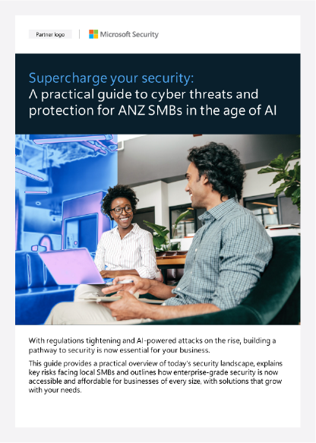


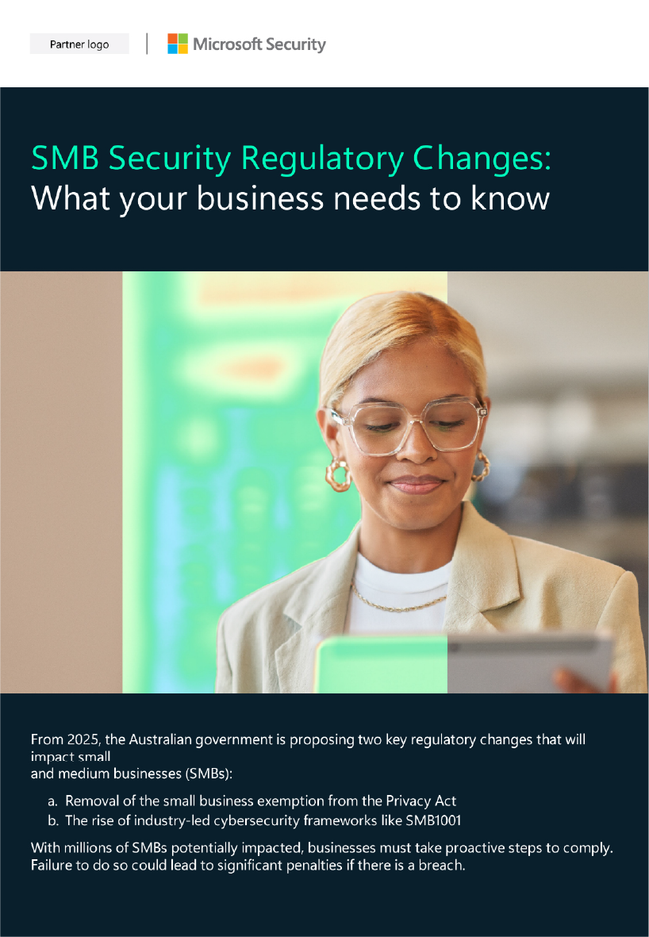



Partner customisation guidance
Partner logo
This template provides an example that can be customised for your brand and taken advantage of as a starting point for creating your own gated landing page hosted on your website or elsewhere. The text provided is directed at the e-book but can be adapted and used for gating the infographic as well.
Supercharge your security
Cyber protection for SMBs in the age of AI
Yellow highlights in this template indicate the areas where text or graphics should be customised for your brand.
With regulations tightening and AI-powered attacks on the rise, now is the time to secure your business.
The good news is that enterprise-grade security is now within reach for businesses of every size, with solutions that grow with your needs.
Download your complementary Book:
1
Replace the “Partner Logo” placeholder with your company logo where applicable.
Per Microsoft Partner Brand Guidelines, ensure your logo is 120 percent of the size of the Microsoft Security logo. See more partner co-branding guidance here.
We can help protect you from critical security risks facing your business:
Data Security
Identity Protection
Device Protection
First Name *
2
Replace all instances of “Partner Name” or “Partner Solution” with your own company/solution name and add any additional partner-specific content where identified. Be sure to remove the yellow highlighting and change the font color to match the surrounding text.
Last Name *
3
Lead collection form is shown as an example only.
You will need to create your own form, including which input fields that you would like to collect from customers. Best practice is to require as few fields as possible. Also, be mindful of your use of PII (personally identifying information) that you collect and be sure to include any applicable disclaimers regarding your use of the collected information on the landing page.
Prevent breaches and safeguard IP, information
and financial records
Secure credentials,
passwords, and
authentication processes
Shield every
connected device
from cyber threats
Email *
Company name
eBook: Your SMB Security Roadmap
This practical guide explores today's evolving threat landscape, identifies specific risks facing ANZ businesses and demonstrates how to implement scalable, enterprise-grade security solutions within your budget.
Instant download
Privacy
Free resources:
SMB Security Regulatory Changes: What you need to know
Security Industry Insights
Learn about important changes to the Privacy Act and the new SMB1001 cybersecurity compliance framework.
Access specialised security guidance tailored to your industry's unique challenges.
Healthcare
{Insert relevant links}
Financial Services
Insurance
Retail
Download
Government
[Partner Name]: Your proven security specialists
Our Microsoft-certified security specialists help SMBs stay ahead of threats with tailored, scalable protection. [If relevant, add a description of the partner's practice and security services, capabilities, experience, industry specialisations, accreditations, etc.]
Contact us today to learn more or schedule your free security assessment.
[Insert partner contact details: Name | Phone | email | website]

